Slide 1

Fundamental use cases for artificial intelligence
Tim ajar kecerdasan artifisial

Slide 2
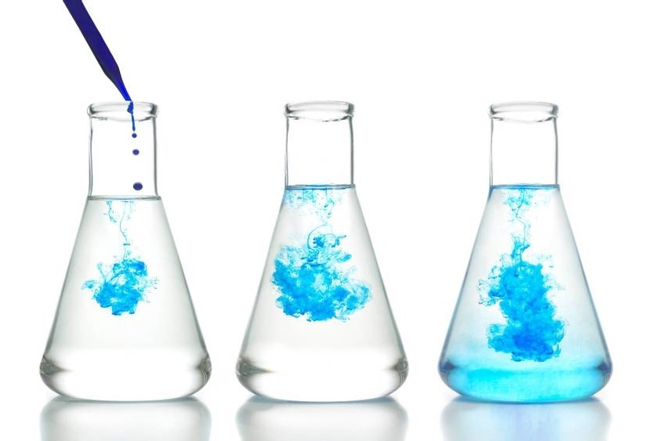
outline
Some representative ai use cases
The jobs that will take the longest to replace by automation

Slide 3
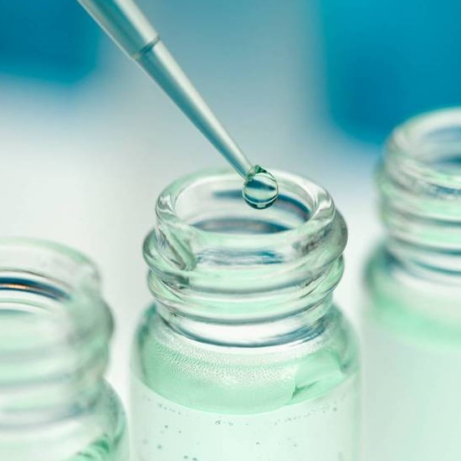
Representative ai use cases
From finance to medicine, it is difficult to find an industry that is not being disrupted by Artificial Intelligence. We will focus on real-world examples of the most popular applications of AI in our everyday life.
Artificial Intelligence, cognitive computing, machine learning, and deep learning are only some of the disruptive technologies that are enabling rapid change today. These technologies can be adopted quicker because of advances in cloud computing, Internet of Things (IoT), and edge computing.

Slide 4

DIGITAL personal assistants and chatbots

Slide 5
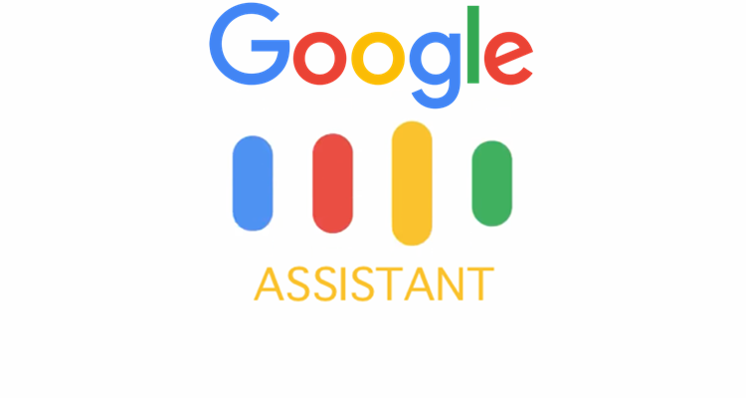


Digital personal assistants and chatbots
All these assistants will allow you to perform all or at least most of these tasks:
Control devices in your home
Play music and display videos on command
Set timers and reminders
Make appointments
Send text and email messages
Make phone calls
Open applications
Read notifications
Perform translations
Order from e-commerce sites

Slide 6
Personal chauffeur

Slide 7
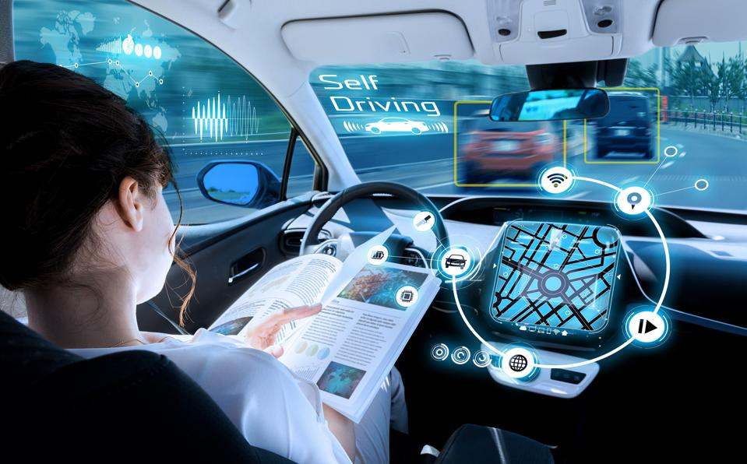
Personal chauffeur
Self-driving or driverless cars are vehicles that can travel along a pre-established route with no human assistance.
Most self-driving cars in existence today do not rely on a single sensor and navigation method and use a variety of technologies such as radar, sonar, lidar, computer vision, and GPS.
As technologies emerge, industries start creating standards to implement and measure their progress. Driverless technologies are no different

Slide 8
J3016 standard
LEVEL 3 (conditional automation)
Under the right conditions, the computer can control the car, including monitoring the environment. If the car encounters a scenario that it cannot handle, it requests that the driver intervene and take control.. Eg Audi Traffic Jam Pilot
Level 0 (no automation)
No self-driving capabilities
LEVEL 4 (HIGH automation)
Level 1 (driver assistance)
The car does not need human involvement under most conditions but still needs human assistance under some road, weather, or geographic conditions
the car controls either the steering or the vehicle speed, but not both simultaneously. The driver performs all other aspects of driving and has full responsibility for monitoring the road and taking over if the assistance system fails to act appropriately. Eg. Adaptive cruise control
LEVEL 5 (full automation)
LEVEL 2 (Partial automation)
The driverless system can control and operate the car on any road and under any conditions that a human driver could handle. The "operator" of the car only needs to enter a destination. Nothing at this level is in production yet but a few companies are close and might be there by the time the book is published
The car can steer, accelerate, and brake in certain circumstance. The human driver involvement responding to traffic signals or changing lanes. Eg Tesla autopilot

Slide 9
Who the leading companies
Google's Waymo
As of 2018, Waymo's autonomous cars have driven eight million miles on public roads as well as five billion miles in simulated environments. In the next few years, it is all but a certainty that we will be able to purchase a car capable of full driving autonomy. Tesla, among others, already offers driver assistance with their Autopilot feature and possibly will be the first company to offer full self-driving capabilities.
Uber ATG
Uber's Advanced Technology Group (ATG) is an Uber subsidiary working on developing self-driving technology. In 2016, Uber launched an experimental car service on the streets of Pittsburgh. Uber has plans to buy up to 24,000 Volvo XC90 and equip them with their self-driving technology and start commercializing them in some capacity by 2021. Tragically, in March 2018, Elaine Herzberg was involved in an incident with an Uber driverless car and died. According to police reports, she was struck by the Uber vehicle while trying to cross the street, while she was watching a video on her phone. Ms. Herzberg became one of the first individuals to die in an incident involving a driverless car.

Slide 10
Shipping and Warehouse management

Slide 11

Shipping and warehouse management
An Amazon sorting facility is one of the best examples of the symbiotic relationship that is forming between humans, computers, and robots.
Computers take customer orders and decide where to route merchandise, the robots act as mules carrying the pallets and inventory around the warehouse. Humans plug the "last mile" problem by hand picking the items that are going into each order.
Robots are proficient in mindlessly repeating a task many times as long as there is a pattern involved and some level of pretraining is involved to achieve this

Slide 12
Human health

Slide 13
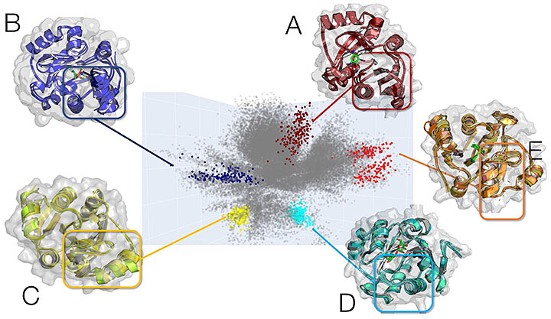
Drugs discovery
AI can assist in generating drug candidates (that is, molecules to be tested for medical application) and then quickly eliminating some of them using constraint satisfaction or experiment simulation.
Deep learning paired with drug docking and molecular dynamics simulations identify small molecules to shut down virus Covid-19 (Brookhaven National Lab)

Slide 14
Insurance pricing
Machine learning algorithms can be used to better price insurance by more accurately predicting how much will be spent on a patient, how good a driver an individual is, or how long a person will live.
As an example, the young.ai project from Insilico Medicine can predict with some accuracy how long someone will live from a blood sample and a photograph.
The blood sample provides 21 biomarkers such as cholesterol level, inflammation markers, hemoglobin counts and albumin level that are used as input to a machine learning model.
Other inputs into the model are ethnicity and age, as well as a photograph of the person.
https://liveforever.club/resources/young-ai

Slide 15
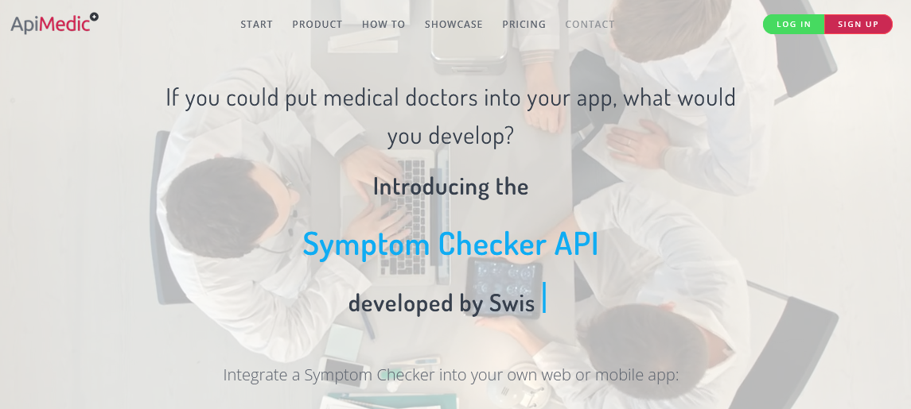
Patient diagnosis
Doctors can make better diagnosis on their patients and be more productive in their practice
As an example:
ApiMedic offers a medical symptom checker primarily for patients. Based on the entered symptoms it tells the patient what possible diseases he has. It directs him to more medical information and shows the right doctor for further clarifications. The symptom checker can be integrated via the flexible API (Application Programming Interface). This is a modular programming interface, which offers the symptom checker functionalities for a main program.
https://apimedic.com/

Slide 16
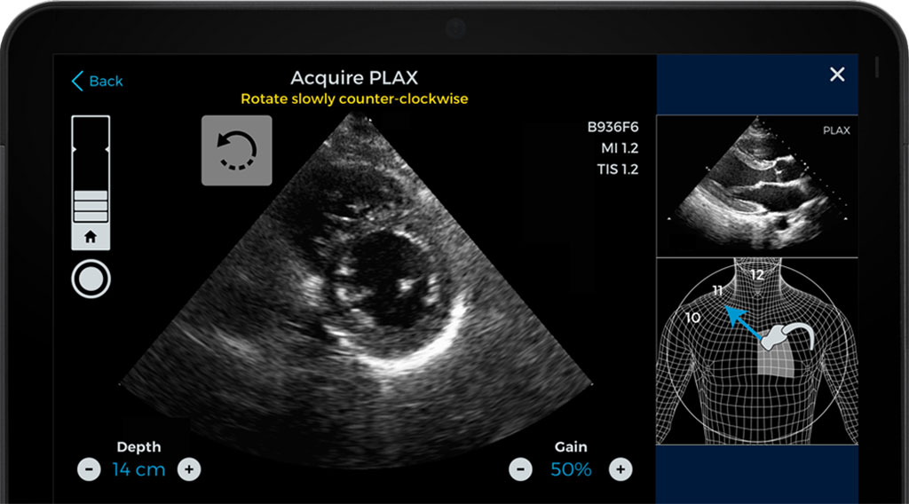
Medical imaging interpretation
Medical imaging data is a complex and rich source of information about patients.
CAT scans, MRIs, and X-rays contain information that is otherwise unavailable.
There is a shortage of radiologists and clinicians that can interpret them.
Getting results from these images can sometimes take days and can sometimes be misinterpreted.
Recent studies have found that machine learning models can perform just as well, if not better, than their human counterparts

Slide 17
Psychiatric analysis
An hour-long session with a psychiatrist can costs hundreds of dollars. We are on the cusp of being able to simulate the behavior with AI chatbots. At the very least, these bots will be able to offer follow-up care from the sessions with the psychiatrist and help with a patient's care between doctor's visits.
A more recent and advanced example is Ellie. Ellie was created by the Institute for Creative Technologies at the University of Southern California. It helps with the treatment of people with depression or post-traumatic stress disorder.
Ellie is a virtual therapist (she appears on screen), responds to emotional cues, nods affirmatively when appropriate and shifts in her seat.
She can sense 66 points on a person's face and use these inputs to read a person's emotional state. One of Ellie's secrets is that she is obviously not human and that makes people feel less judged and more comfortable opening up to her

Slide 18
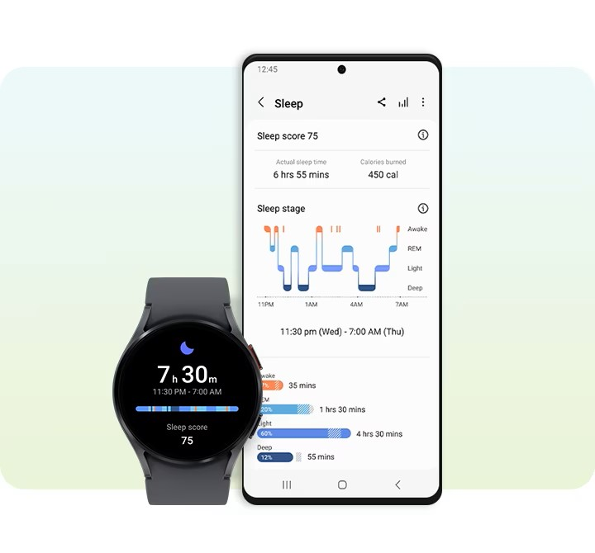
Smart health record
Medicine is notorious for being a laggard in moving to electronic records.
Data science provides a variety of methods to streamline the capture of patient data including OCR, handwriting recognition, voice to text capture, and real-time reading and analysis of patient's vital signs.
It is not hard to imagine a future coming soon where this information can be analyzed in real-time by AI engines to take decisions such as adjusting body glucose levels, administering a medicine, or summoning medical help because a health problem is imminent.

Slide 19
Knowledge search

Slide 20
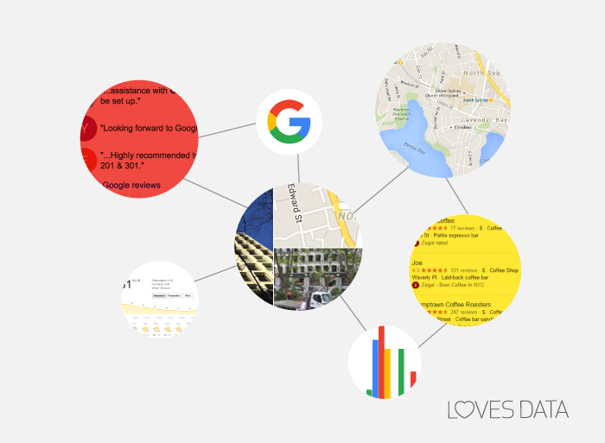
Knowledge search
We have gotten to a point where, in some cases, we don't even realize we are using artificial intelligence.
A sign that a technology or product is good is when we don't necessarily stop to think how it's doing what it is doing. A perfect example of this is Google Search.
The product has become ubiquitous in our lives and we don't realize how much it relies on artificial intelligence to produce its amazing results.
From its Google Suggest technology to its constant improvement of the relevancy of its results, AI is deeply embedded in its search process.

Slide 21
Recommendation system

Slide 22
Recommendation system
Recommendation systems are another example of AI technology that has been weaved into our everyday lives.
Amazon, YouTube, Netflix, LinkedIn, and Facebook all rely on recommendation technology and we don't even realize we are using it.
Recommendation systems rely heavily on data and the more data that is at their disposable, the more powerful they become

Slide 23
The smart home

Slide 24
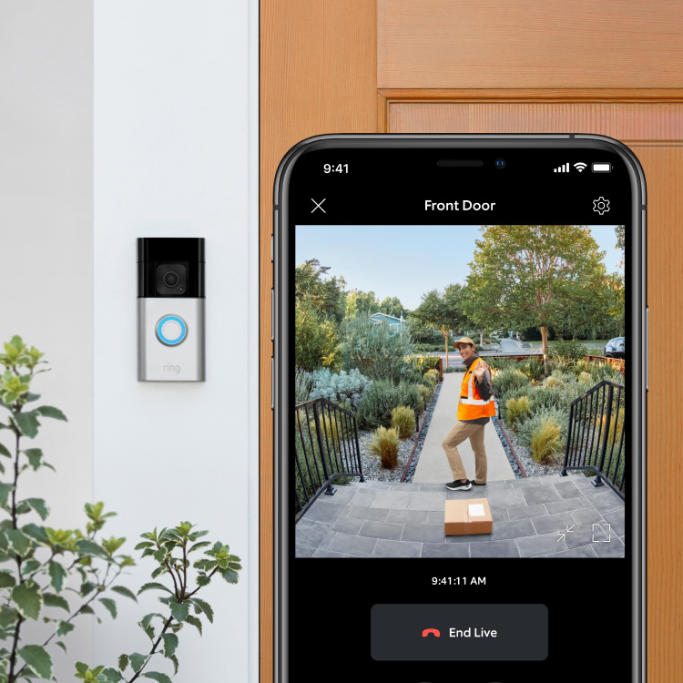
Home Monitoring
Home monitoring is one area where great solutions are generally available already.
The Ring video doorbell from Amazon and the Google Nest thermostat are two inexpensive options that are widely available and popular.
These are two simple examples of smart home devices that are available for purchase today.
The Ring video doorbell is a smart home device connected to the internet that can notify the homeowner of activity at their home, such as a visitor, via their smartphone

Slide 25
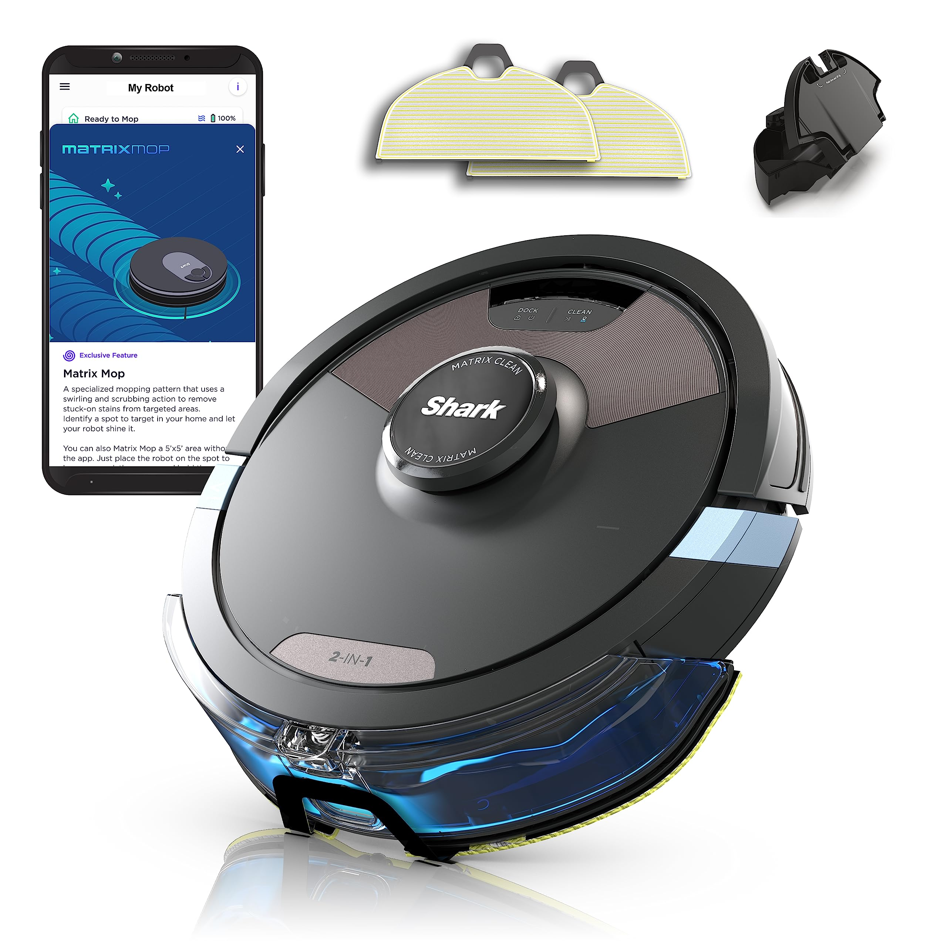
Vacuuming and mopping
Two tasks that have been popular to hand off to robots are vacuuming and mopping.
A robotic vacuum cleaner is an autonomous robotic vacuum cleaner that uses AI to vacuum a surface.
Depending on the design, some of these machines use spinning brushes to reach tight corners and some models include several other features in addition to being able to vacuum, such as mopping and UV sterilization.
Much of the credit for popularizing this technology goes to the company (not the film), iRobot. iRobot was started in 1990 by Rodney Brooks, Colin Angle, and Helen Greiner after meeting each other while working in MIT's Artificial Intelligence Lab.
iRobot is best known for its vacuuming robot (Roomba), but for a long time they also had a division devoted to the development of military robots

Slide 26
gaming

Slide 27
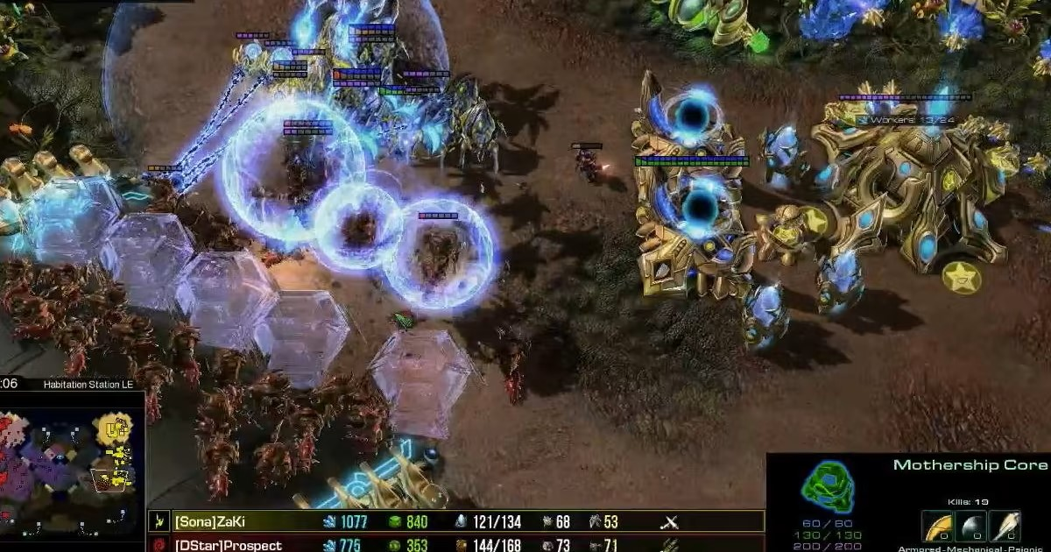
StarCraft 2
Video games have been used for decades as a benchmark to test the performance of AI systems.
As capabilities increase, researchers work with more complex games that require different types of intelligence.
The strategies and techniques developed from this game playing can transfer to solving real-world problems.
The game of StarCraft II is considered one of the hardest, though it is an ancient game by video game standards.
The team at DeepMind introduced a program dubbed AlphaStar that can play StarCraft II and was for the first time able to defeat a top professional player

Slide 28
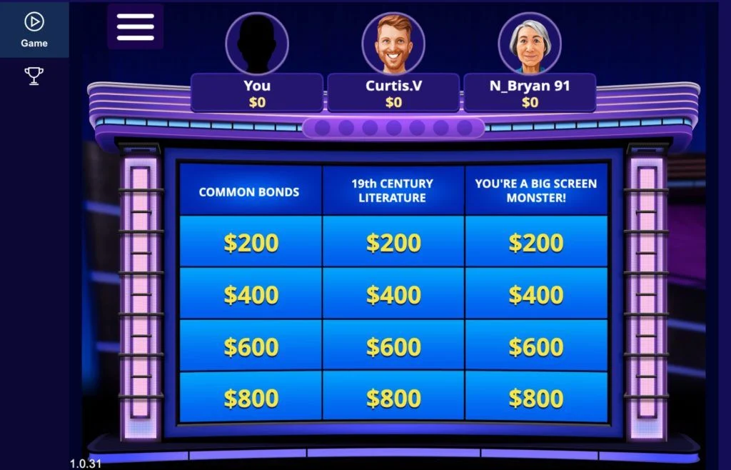
Jeopardy
IBM and the Watson team made history in 2011 when they devised a system that was able to beat two of the most successful Jeopardy champions.
Ken Jennings has the longest unbeaten run in the show's history with 74 consecutive appearances.
Brad Rutter had the distinction of winning the biggest prize pot with a total of $3.25 million.

Slide 29
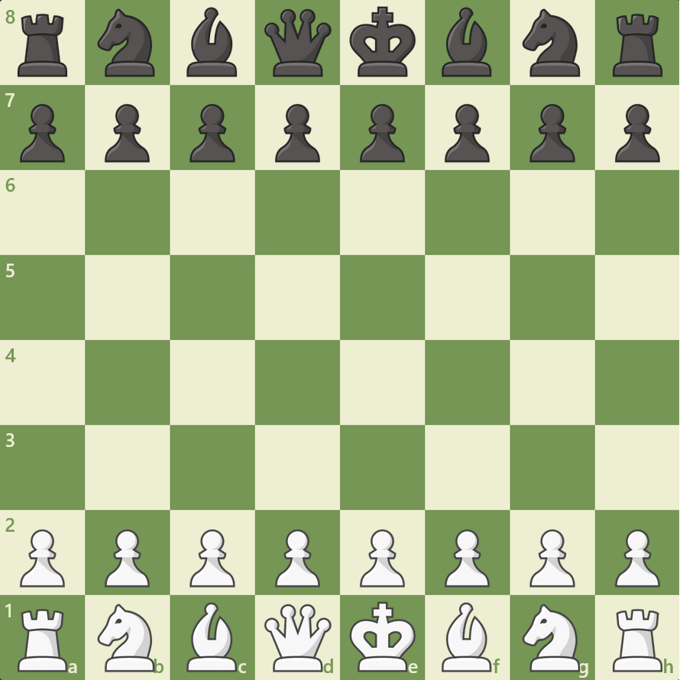
Chess
remember the news when Deep Blue famously beat chess grand master Gary Kasparov in 1996. Deep Blue was a chess-playing application created by IBM. In the first round of play Deep Blue won the first game against Gary Kasparov. However, they were scheduled to play six games. Kasparov won three and drew two of the following five games thus defeating Deep Blue by a score of 4–2. The Deep Blue team went back to the drawing board, made a lot of enhancements to the software, and played Kasparov again in 1997. Deep Blue won the second round against Kasparov winning the six-game rematch by a score of 3½–2½. It then became the first computer system to beat a current world champion in a match under standard chess tournament rules and time controls.
A lesser known example, and a sign that machines beating humans is becoming common place, is the achievement in the area of chess by the AlphaZero team. Google scientists from their AlphaZero research team created a system in 2017 that took just four hours to learn the rules of chess before crushing the most advanced world champion chess program at the time called Stockfish

Slide 30
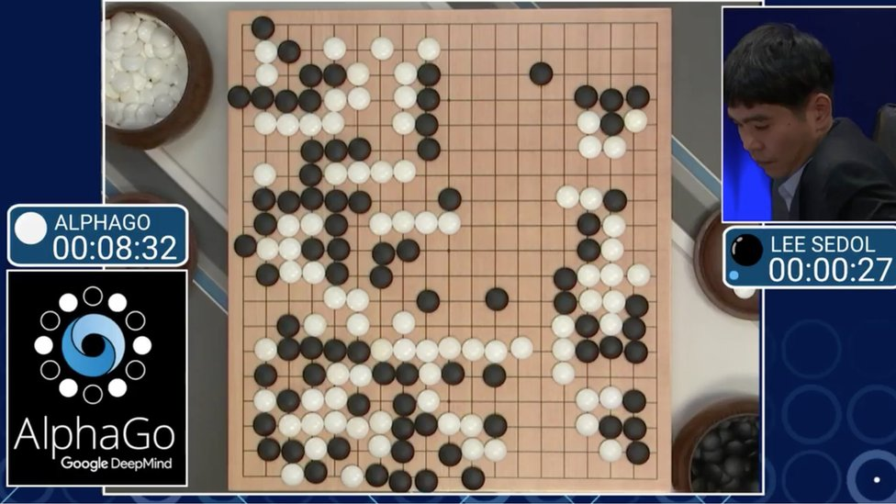
AlphaGo
In October 2015, the original AlphaGo became the first computer Go program to beat a human professional Go player without handicaps on a full-sized 19 x 19 board. In March 2016, it beat Lee Sedol in a five-game match.
This became the first time a Go program beat a 9-dan professional without handicaps. Although AlphaGo lost to Lee Sedol in the fourth game, Lee resigned in the final game, giving a final score of 4 games to 1. At the 2017 Future of Go Summit, the successor to AlphaGo called AlphaGo Master beat the master Ke Jie in a three-game match. Ke Jie was ranked the world No.1 ranked player at the time.
After this, AlphaGo was awarded professional 9-dan by the Chinese Weiqi Association. AlphaGo and its successors use a Monte Carlo tree search algorithm to find their moves based on knowledge previously "learned" by machine learning, specifically using deep learning and training, both playing with humans and by itself.
The model is trained to predict AlphaGo's own moves and the winner's games. This neural net improves the strength of tree search, resulting in better moves and stronger play in following games

Slide 31
Movie making

Slide 32
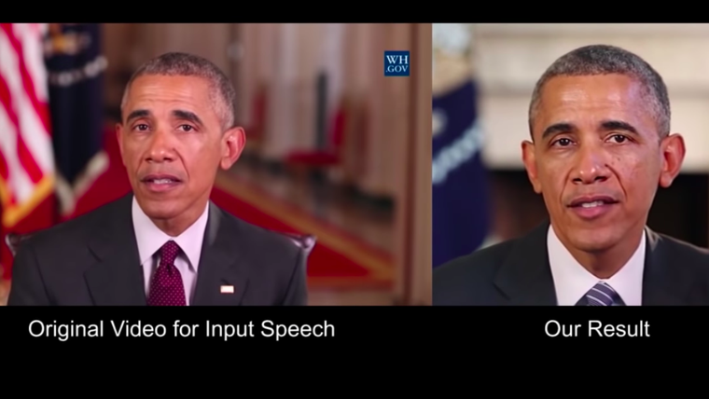
Deepfakes
A deepfake is a portmanteau, or blend, of "deep learning" and "fake." It is an AI technique to merge video images.
A common application is to overlap someone's face onto another.
A nefarious version of this was used to merge pornographic scenes with famous people or to create revenge porn.
Deepfakes can also be used to create fake news or hoaxes.
As you can imagine, there are severe societal implications if this technology is misused.
One recent version of similar software was developed by a Chinese company called Momo who developed an app called Zao. It allows you to overlap someone's face over short movie clips like Titanic and the results are impressive

Slide 33
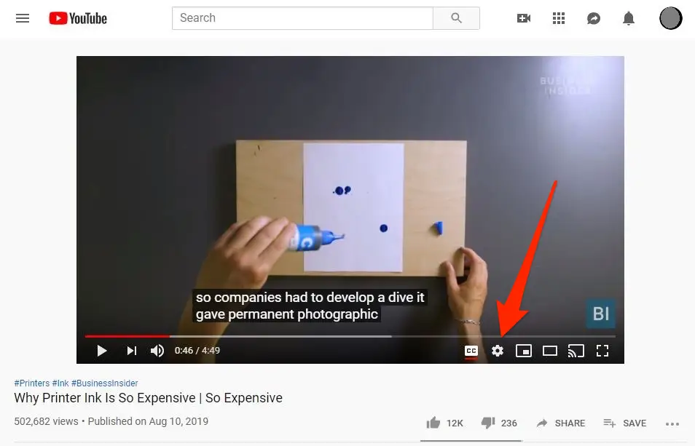
Movie Script Generation
They are not going to win any Academy Awards any time soon, but there are a couple projects dedicated to producing movie scripts.
One of the most famous examples is Sunspring. Sunspring is an experimental science fiction short film released in 2016. It was entirely written by using deep learning techniques.
The film's script was created using a long short-term memory (LSTM) model dubbed Benjamin.
Its creators are BAFTA-nominated filmmaker Oscar Sharp and NYU AI researcher Ross Goodwin. The actors in the film are Thomas Middleditch, Elisabeth Grey, and Humphrey Ker.
Their character names are H, H2, and C, living in the future. They eventually connect with each other and a love triangle forms

Slide 34
Advances in AI will have wide implications for our society and at some point, we will have to deal with these questions

Slide 35

The questions
What happens if an AI became so evolved that it became conscious? Should it be given rights?
If a robot replaces a human, should companies be required to continue paying payroll tax for that displaced worker?
Will we get to a point where computers are doing everything, and if so, how will we adapt to this; how will we spend our time?
Worse yet, does the technology enable a few individuals to control all resources? Will a universal income society emerge in which individuals can pursue their own interests? Or will the displaced masses live in poverty?

Slide 36

assignment
Discuss with your friends, and write your opinion regarding the questions on the previous slide.
find at least 1 other AI use cases, create the infographics
Notes:
Penilaian: 1. logis tidaknya alasan yang mendukung pendapat tersebut
2. Kelengkapan info, kejelasan penerapan AI

Slide 37


Thank you

